Slide 1
ANALYSIS FOR UNIVERSITY
MENU
ANALYSIS
CONTACT
UNIVERSITY TRENDS
DATA
The HackerStreet Boys

Slide 2


OUR TEAM
Benfenati domenico
Carandente vincenzo
MENU
ANALYSIS
CONTACT
UNIVERSITY TRENDS
Master’s Degree in Computer Engineering at the Federico II University of Naples
Master’s Degree in Computer Engineering at the Federico II University of Naples

Slide 3
TABLE OF CONTENT
Problem statement
Data collecting
01
02
Data cleaning
Data analysis
03
04
MENU
ANALYSIS
CONTACT
UNIVERSITY TRENDS
What business problem am I trying to solve?
What kind of data I need for analysis?
What are the most important data among those collected?
What can I say about this data?

Slide 4
Problem statement
01
MENU
ANALYSIS
CONTACT
UNIVERSITY TRENDS
Understand business and business goals

Slide 5
Problem statement
MENU
ANALYSIS
CONTACT
UNIVERSITY TRENDS
The various analysis are oriented to the research of trends related to the
enrollment of students in the different courses of study, based on demography, background and employment opportunities

Slide 6
pros VS cons
Lots of data
low Information
MENU
ANALYSIS
CONTACT
UNIVERSITY TRENDS
You have a large amount of data, all useful for different purposes…
VS
… but not all of it contains interesting information to analyse

Slide 7

METHODS, TECHNIQUES AND TOOLS
MENU
ANALYSIS
CONTACT
UNIVERSITY TRENDS
The process was based on three fundamental steps:
Identify the state of the art
Predict data trends
Find ways to manipulate what will be

Slide 8






METHODS, TECHNIQUES AND TOOLS
MENU
ANALYSIS
CONTACT
UNIVERSITY TRENDS
Google Colab
Pandas
Excel
PowerBI
Folium

Slide 9
data collection
02
MENU
ANALYSIS
CONTACT
UNIVERSITY TRENDS
Collecting and aggregate data

Slide 10

Data sources
Third-party data
MENU
ANALYSIS
CONTACT
UNIVERSITY TRENDS
Quantitative data
Open datasets owned by organizations such as MIUR and ISTAT
Numerical values concerning percentages and absolute values of enrolled students, graduates, etc.

Slide 11


DATA collection
MENU
ANALYSIS
CONTACT
UNIVERSITY TRENDS
Open data
Not only data on students, but also territory and demography
Gathering of the most interesting collections
Time series of all kinds concerning enrolments, graduates, etc.

Slide 12
data cleaning
03
MENU
ANALYSIS
CONTACT
UNIVERSITY TRENDS
Delete superfluous data

Slide 13
Data cleaning process
MENU
ANALYSIS
CONTACT
Filter errors
01
02
Remove unwanted
Removing errors, duplicates or outliers
Filter the observations that have no bearing for the analysis
Filling in
04
03
Bringing structure
If exists some gaps, fill it with other data
Fixing typos and layout issues

Slide 14
data analysis
04
MENU
ANALYSIS
CONTACT
UNIVERSITY TRENDS
Extraction of the information from data

Slide 15
THIS IS A MAP
MENU
ANALYSIS
CONTACT
UNIVERSITY TRENDS
MERCURY
70%
Mercury is the closest planet to the Sun
VENUS
30%
Venus is the second planet from the Sun

Slide 16
UNDERSTANDING DATA
MERCURY
VENUS
MENU
ANALYSIS
CONTACT
UNIVERSITY TRENDS
It’s the closest planet to the Sun and the smallest in the Solar System
Venus has a beautiful name and is the second planet from the Sun

Slide 17


TYPES OF DATA ANALYSIS
DESCRIPTIVE
DIAGNOSTIC
PREDICTIVE
MENU
ANALYSIS
CONTACT
UNIVERSITY TRENDS
PREscripTIVE
Identifies what has already happened
Understanding why something has happened
Identifies future trends based on historical data
Make some raccomandation for the future

Slide 18
descriptive analysis
MENU
ANALYSIS
CONTACT
UNIVERSITY TRENDS

Slide 19
Some numbers
MENU
ANALYSIS
CONTACT
UNIVERSITY TRENDS
universities
35
98
in southern Italy only
25
universities
universities
now active in Italy
have a catchment area of more than 20,000 students

Slide 20
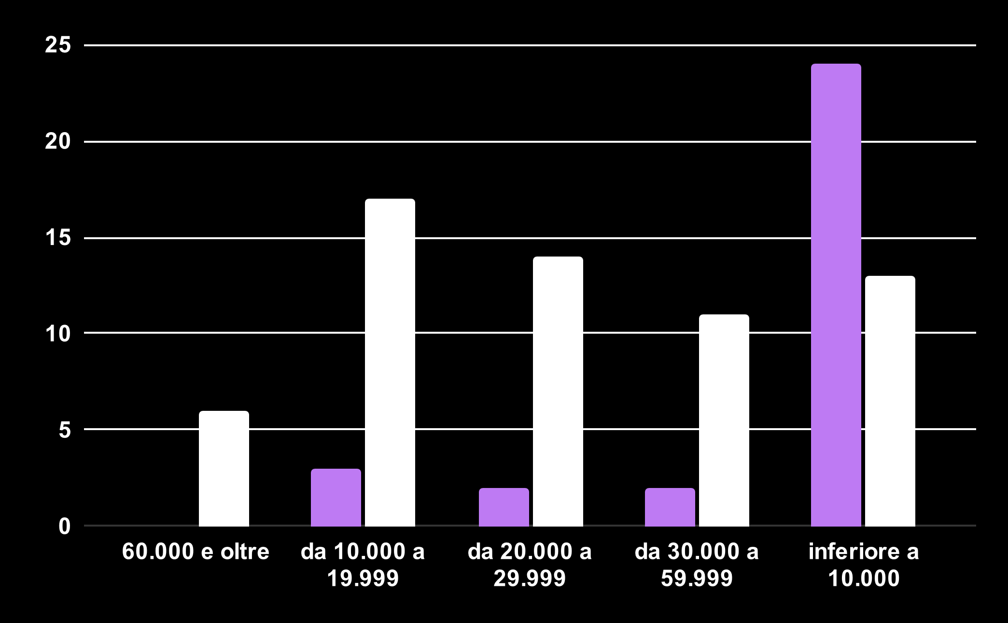
University composition
MENU
ANALYSIS
CONTACT
UNIVERSITY TRENDS
Non-State university
The majority of non-state universities have a catchment area of no more than 10,000 people
state university
Only a few state universities exceed 60,000 people
Source: ISTAT

Slide 21
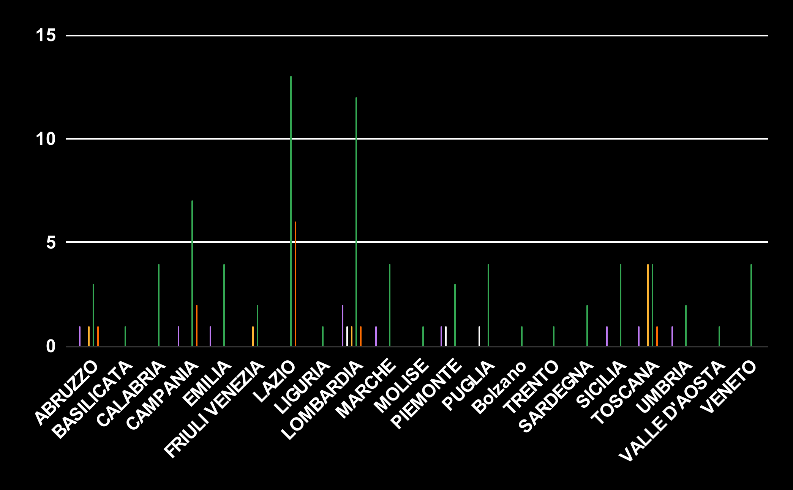
University composition
MENU
ANALYSIS
CONTACT
UNIVERSITY TRENDS
State universities
Lazio is the first region for state universities, followed by Lombardy
telematic universities
Abruzzo, Campania, Lazio, Lombardia and Toscana are the only to have it
Special-Order schools
Tuscany is the best region for number of special-order schools
polytechnics
Only Lombardy, Piemonte and Puglia have just one of it
Source: ISTAT

Slide 22
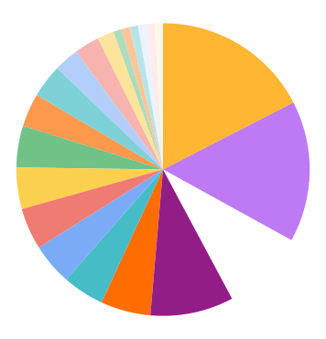
Region per universities
MENU
ANALYSIS
CONTACT
UNIVERSITY TRENDS
17.4%
15.6%
Lazio is the region with most universities
Lombardy is the second for universities
9.2%
9.2%
Campania ranks 4th for number of universities
Tuscany is the third, tie with Campania

Slide 23
490.000
MENU
ANALYSIS
CONTACT
UNIVERSITY TRENDS
3,
..and more students enrolled since 2010

Slide 24
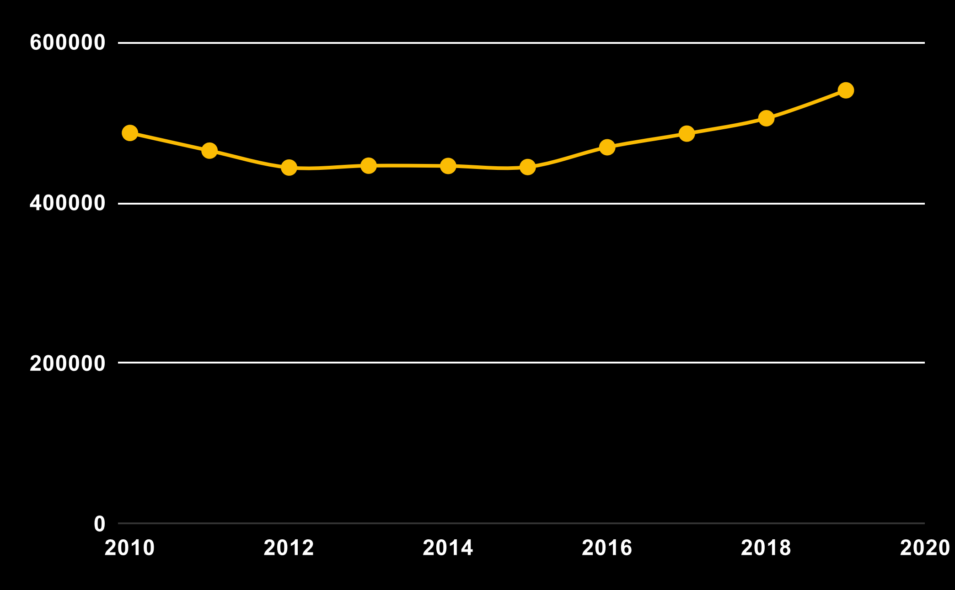
first-year entrants
MENU
ANALYSIS
CONTACT
UNIVERSITY TRENDS
enrollment
The number of enrolments in the first academic year shows an upward trend since 2015
Source: MIUR

Slide 25
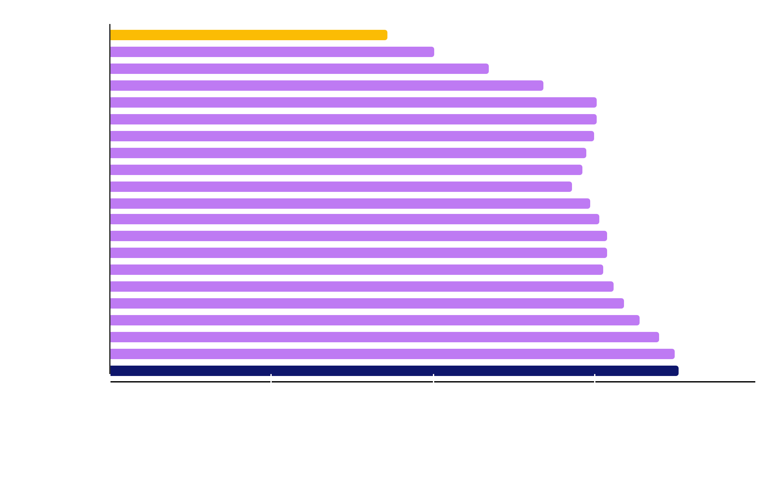
Graduates per years
MENU
ANALYSIS
CONTACT
UNIVERSITY TRENDS
The total number of graduates is up sharply compared to the figures of a few years ago
Source: MIUR

Slide 26
Region enrollment
MENU
ANALYSIS
CONTACT
UNIVERSITY TRENDS
The percentages are calculated according to the population of the region
3% to 4%
Less than 2.5%
More than 4%
2.5% to 3%

Slide 27
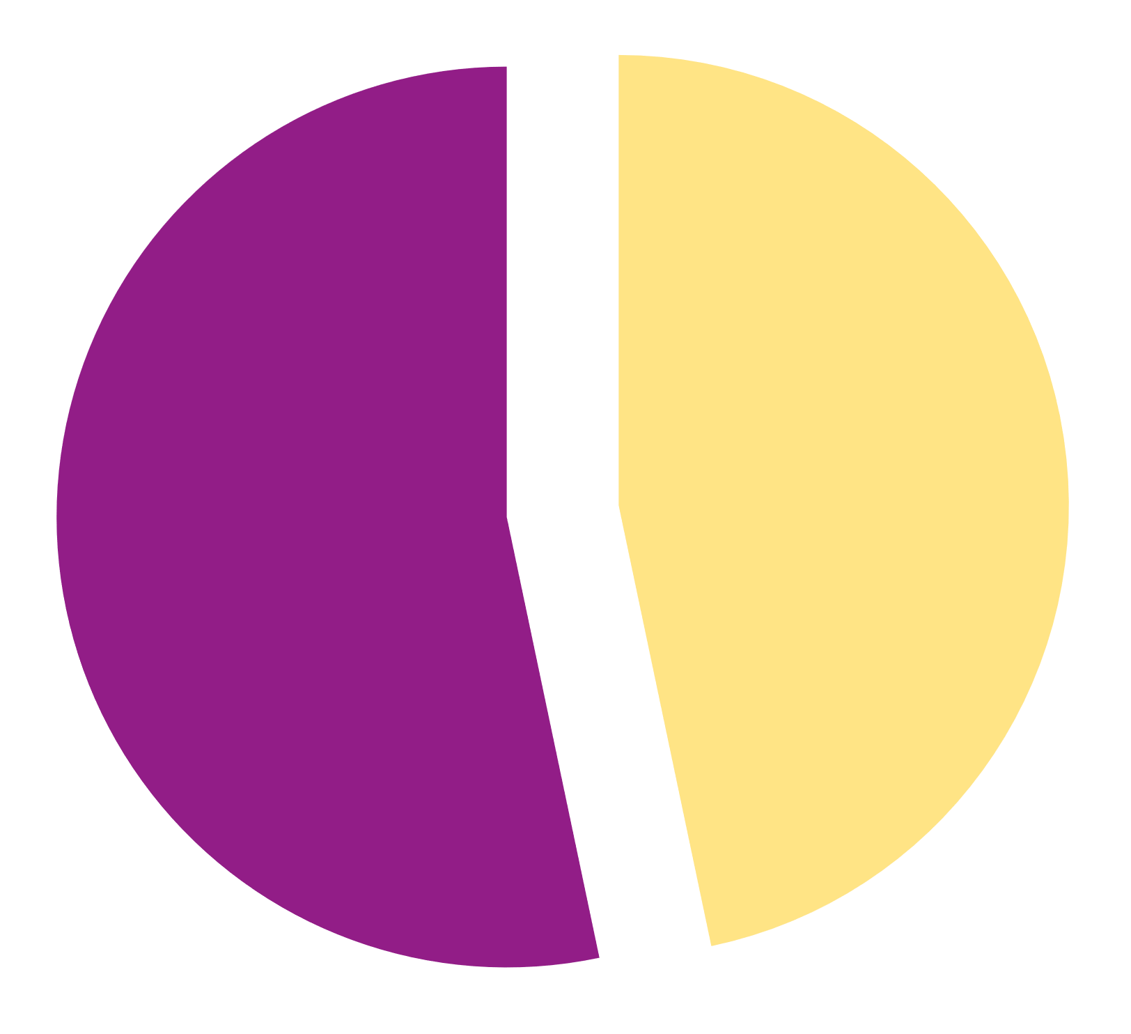
Graduates family background
MENU
ANALYSIS
CONTACT
UNIVERSITY TRENDS
46.7%
of students with parents with a university degree, on the other hand, manage to obtain a bachelor's degree
53.3%
of students with graduate parents manage to obtain a second level degree
Source: ISTAT

Slide 28
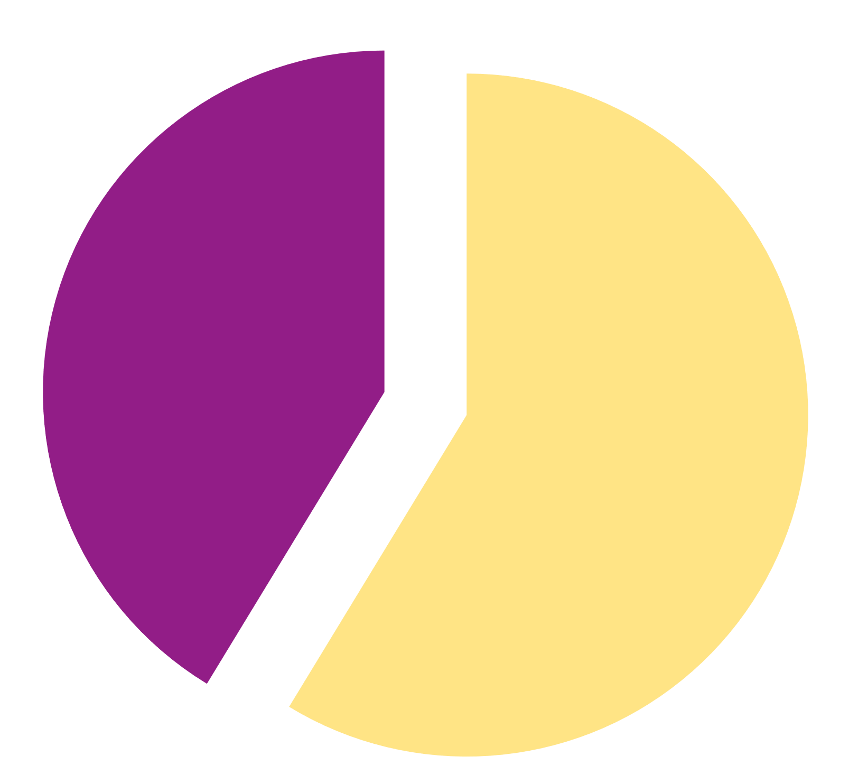
Graduates family background
MENU
ANALYSIS
CONTACT
UNIVERSITY TRENDS
41.3%
of students with non-graduate parents manage to obtain a second level degree
58.7%
of students with parents without a university degree, on the other hand, manage to obtain a bachelor's degree
Source: ISTAT

Slide 29
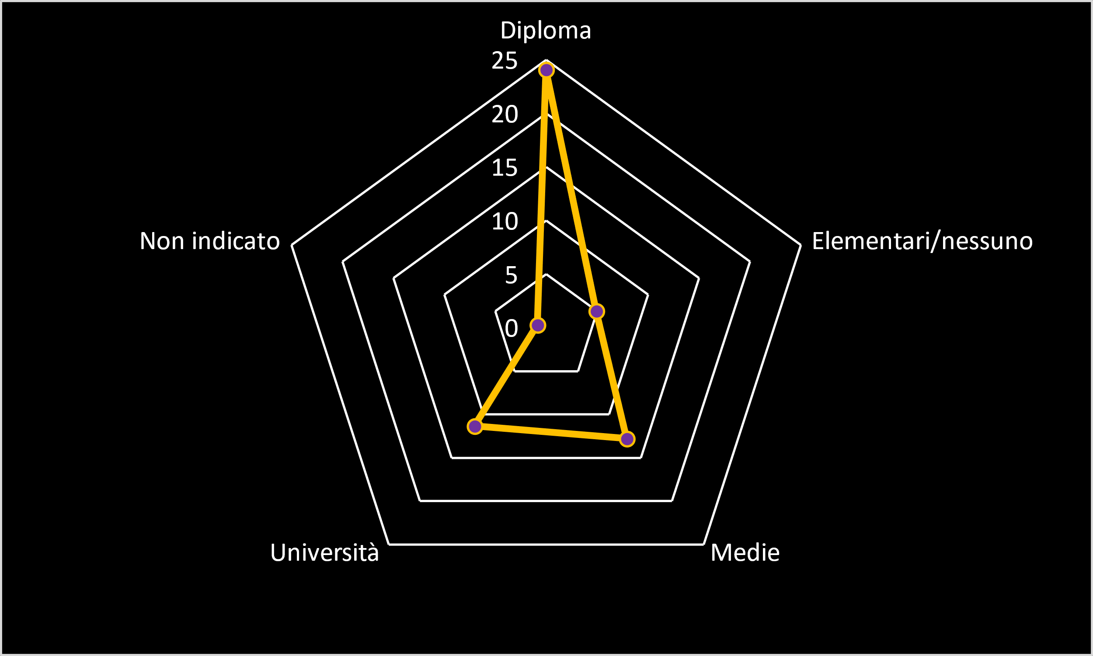
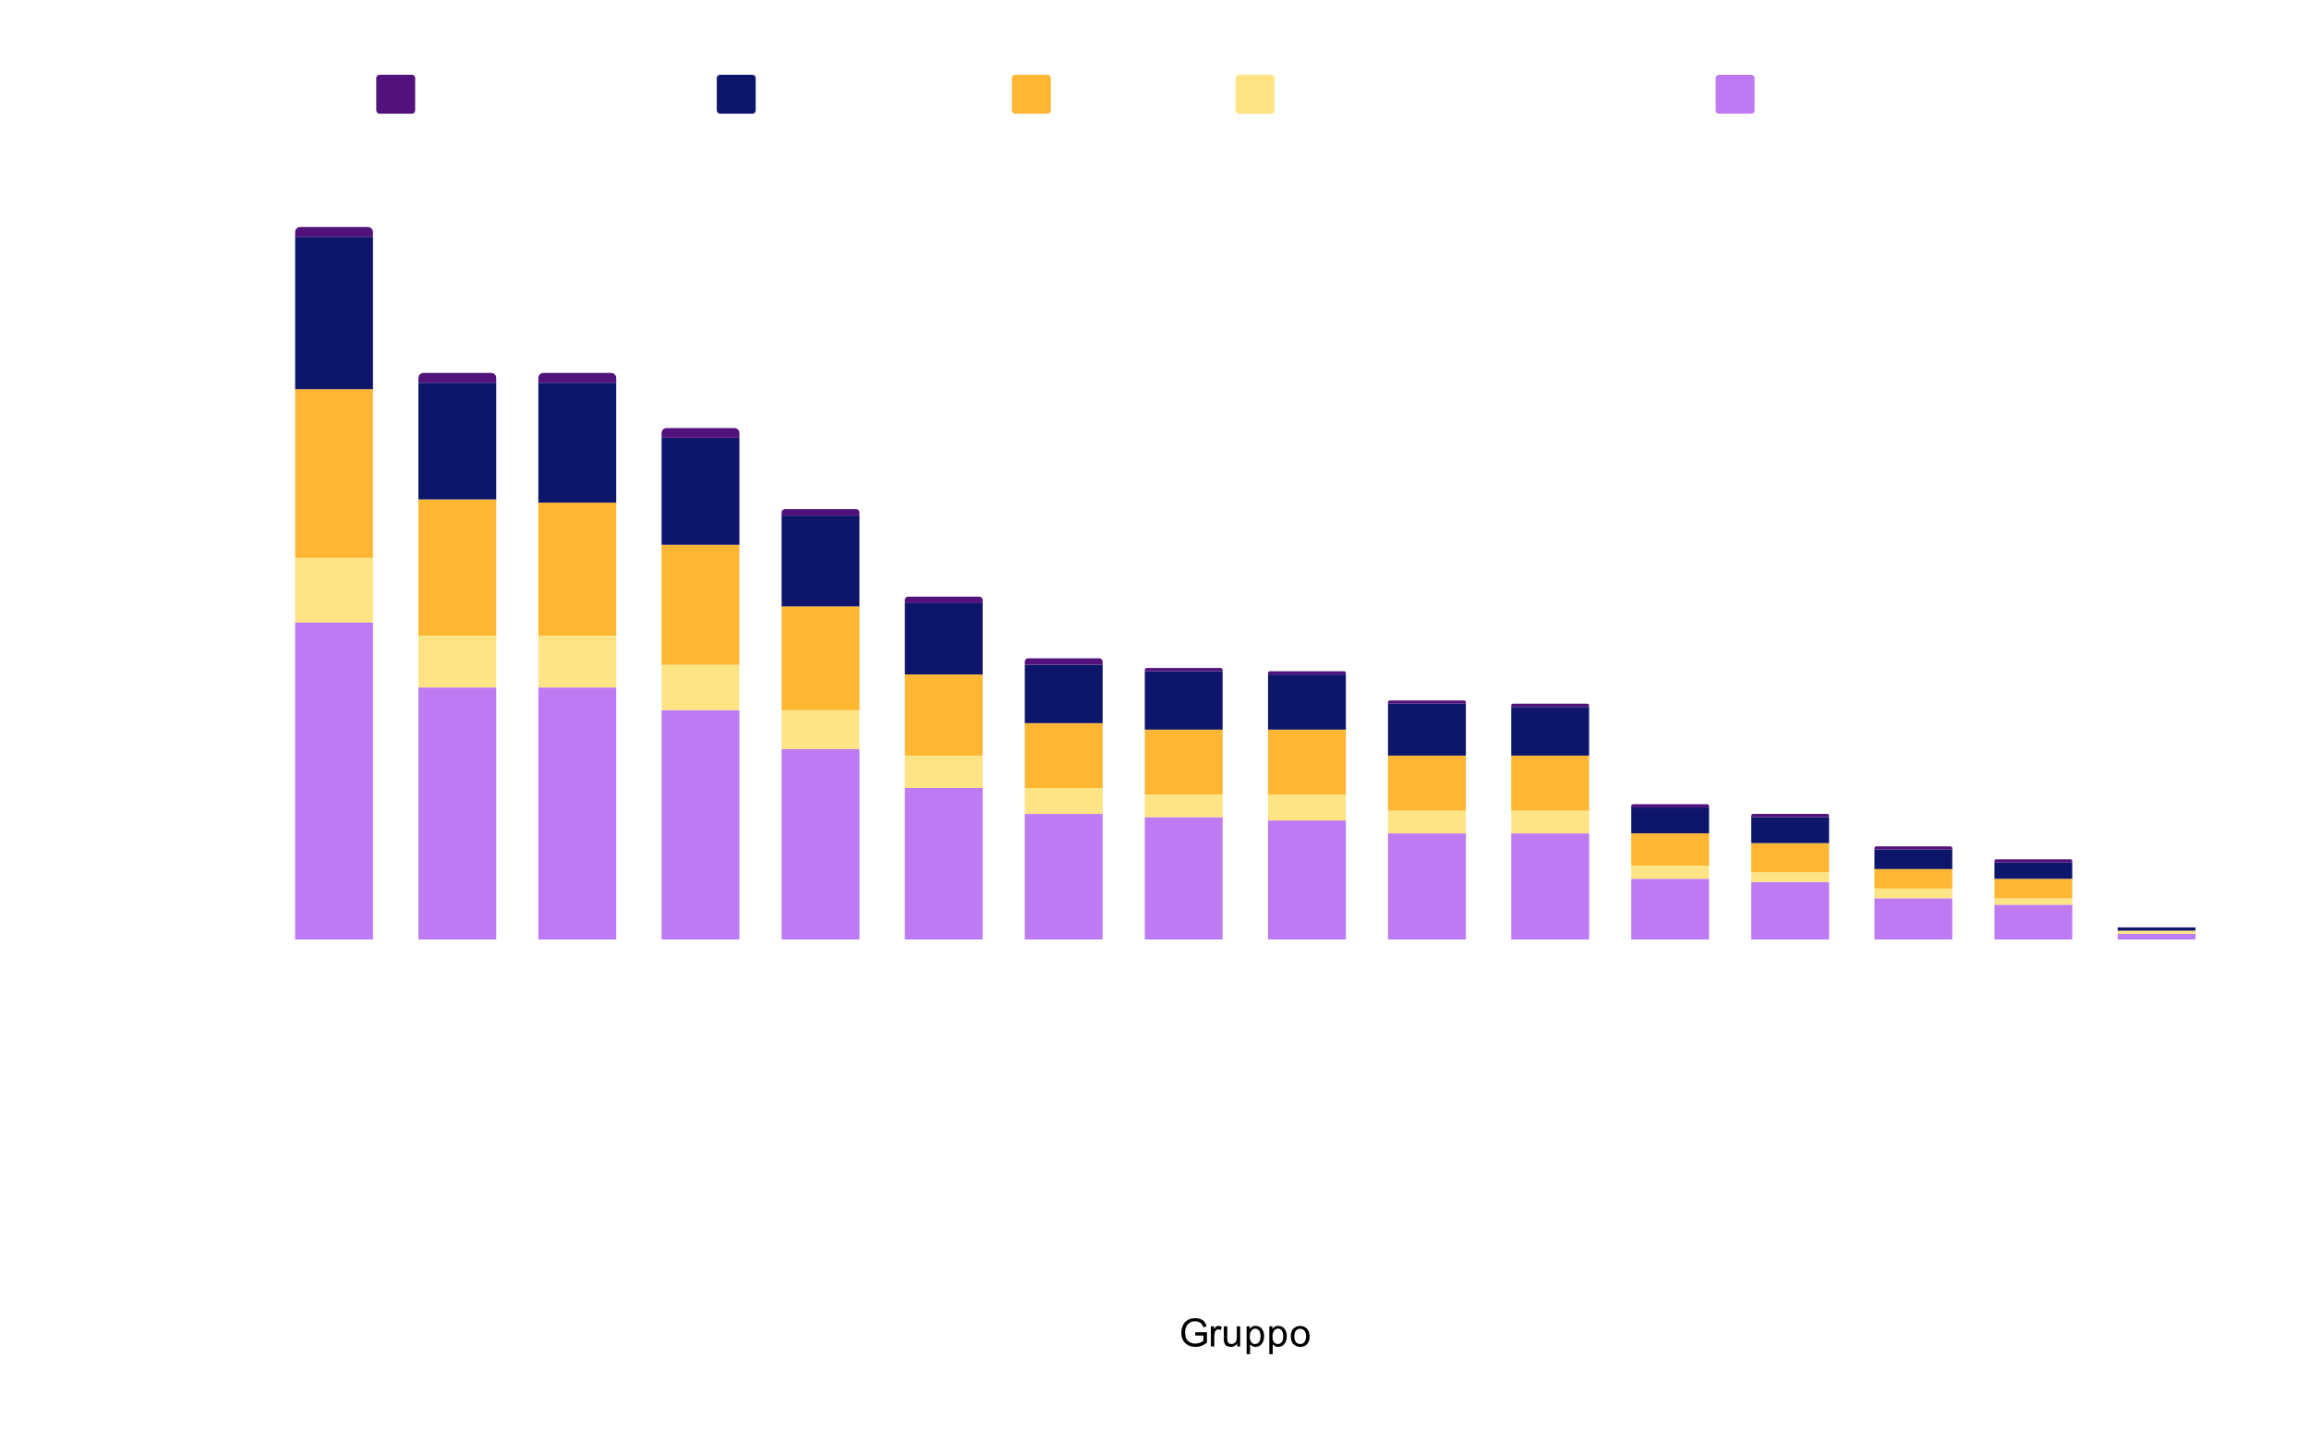
Graduates family background
MENU
ANALYSIS
CONTACT
UNIVERSITY TRENDS
of graduate students have parents who have high school diploma,
24%
while students with graduate parents are only
11%
Source: ISTAT

Slide 30

Gender job search
MENU
ANALYSIS
CONTACT
UNIVERSITY TRENDS
italy
abroad
both
Most males look for work both in Italy and abroad, while females look for work more in Italy.
The figure of those who only look for work abroad is low.
Source: ISTAT

Slide 31
diagnostic analysis
MENU
ANALYSIS
CONTACT
UNIVERSITY TRENDS

Slide 32
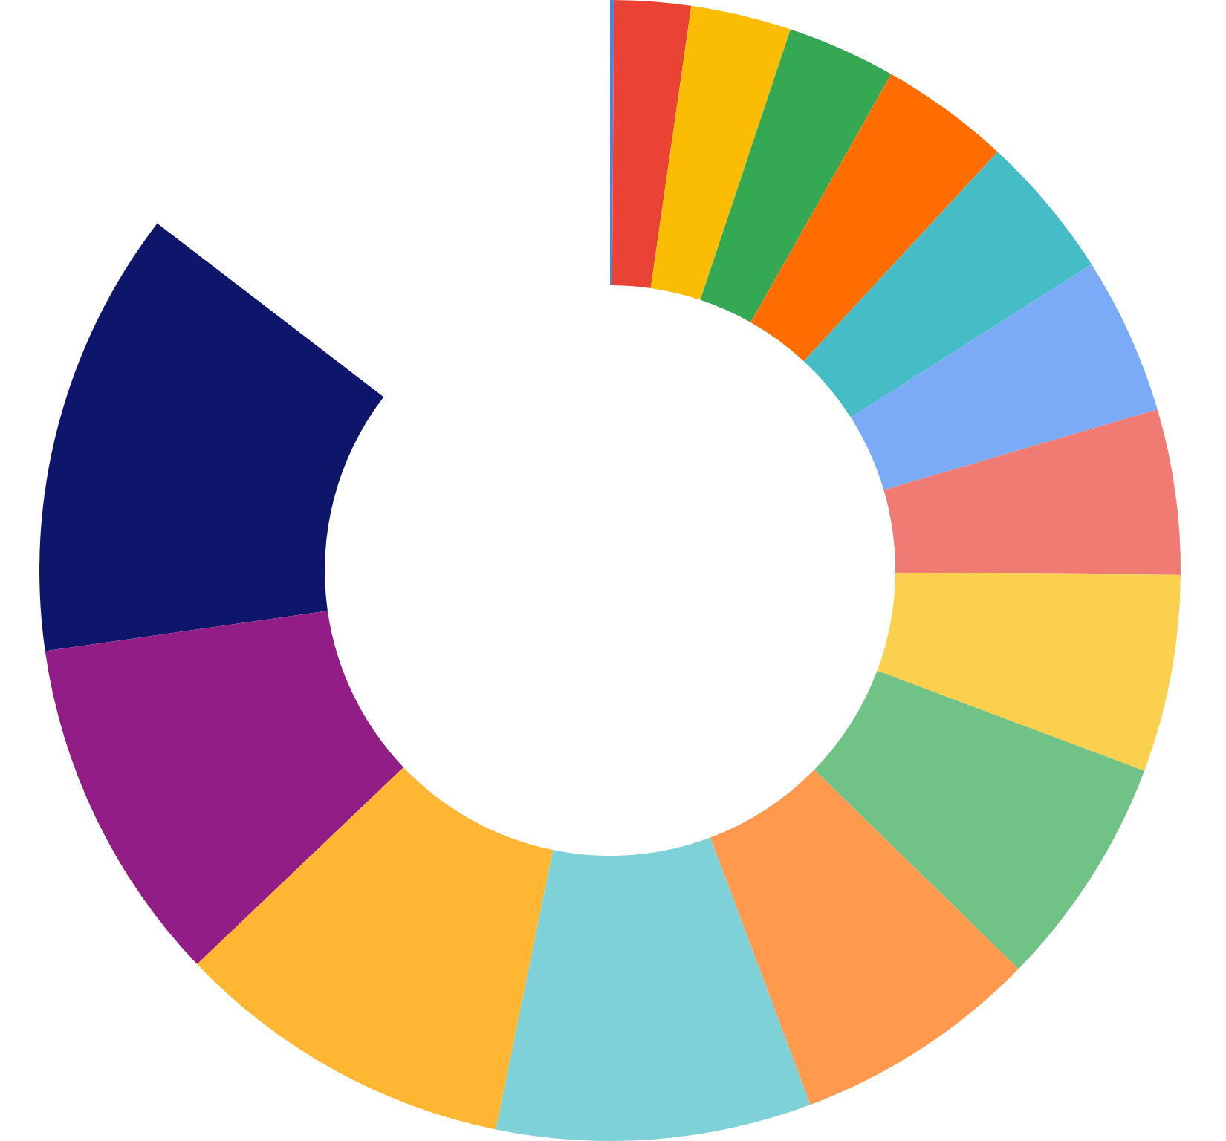
Group enrollment
MENU
ANALYSIS
CONTACT
UNIVERSITY TRENDS
12.7%
14.6%
choose engineering branch
choose economic-statistical branch
enroll to legal branch
9.9%
choose political-social branch
10.9%
Source: ISTAT

Slide 33
50%
MENU
ANALYSIS
CONTACT
UNIVERSITY TRENDS
…but the total number of groups are sixteen !
These four groups alone comprise almost
of students enrolled since 2010.
Why do they choose them?

Slide 34
Branch employment
66%
91%
24%
34%
MENU
ANALYSIS
CONTACT
UNIVERSITY TRENDS
Enrolled in the political-social field work before graduation
Legal students work before graduating
Enrolled in economics and statistics work immediately after graduation
Engineers work or look for work after graduation
Source: ISTAT

Slide 35
regional scores
MENU
ANALYSIS
CONTACT
UNIVERSITY TRENDS
In order to classify regions according to a score, it was decided to consider certain indicators such as
number of library seats
quality of Internet connection
percentage of occupancy
in finding the best region for a student

Slide 36
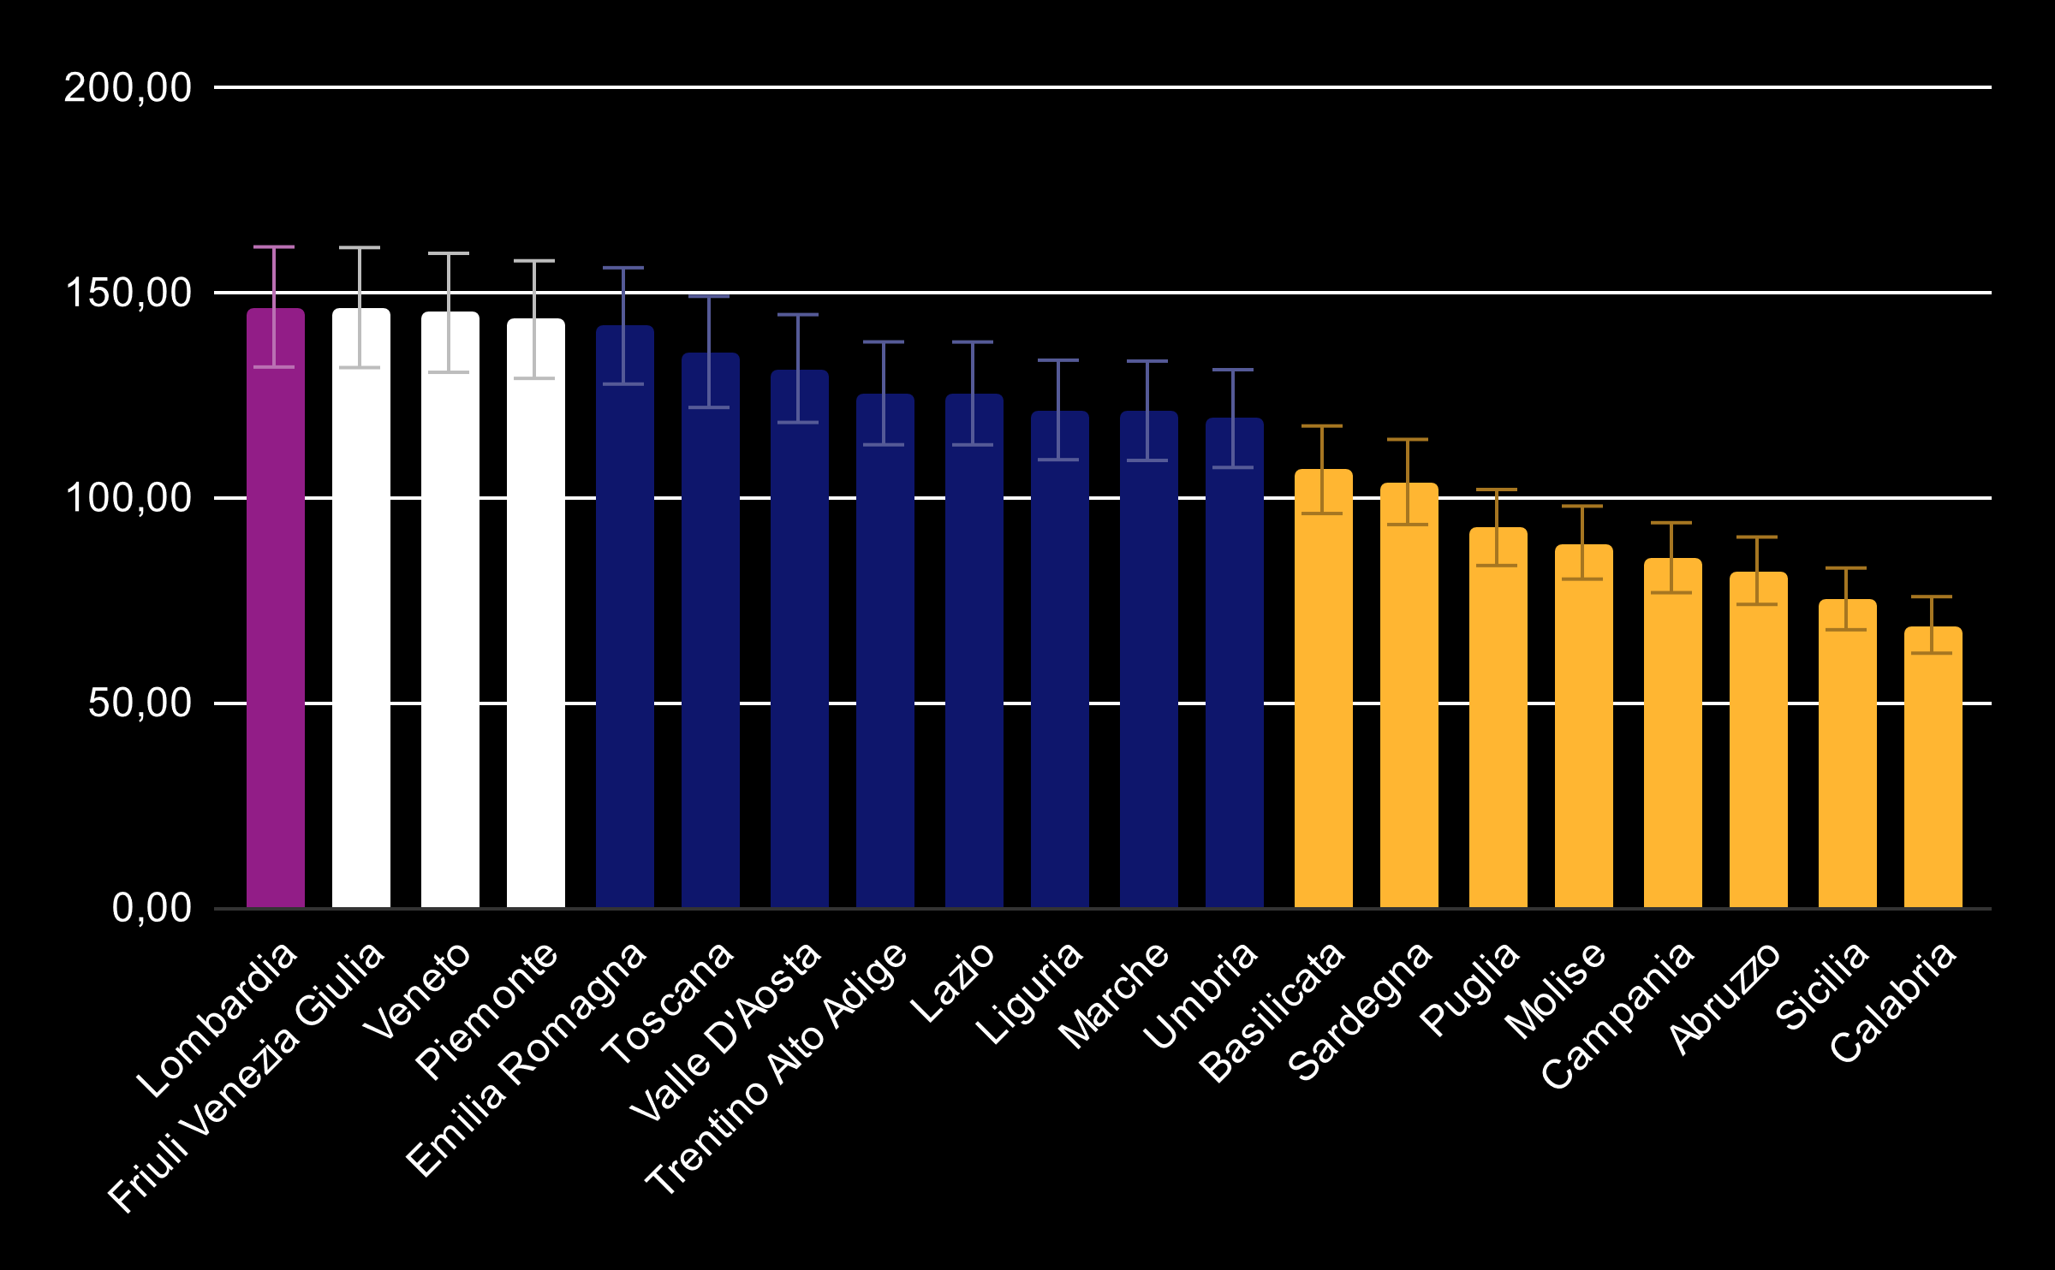
regional scores
MENU
ANALYSIS
CONTACT
UNIVERSITY TRENDS
Source: ISTAT

Slide 37
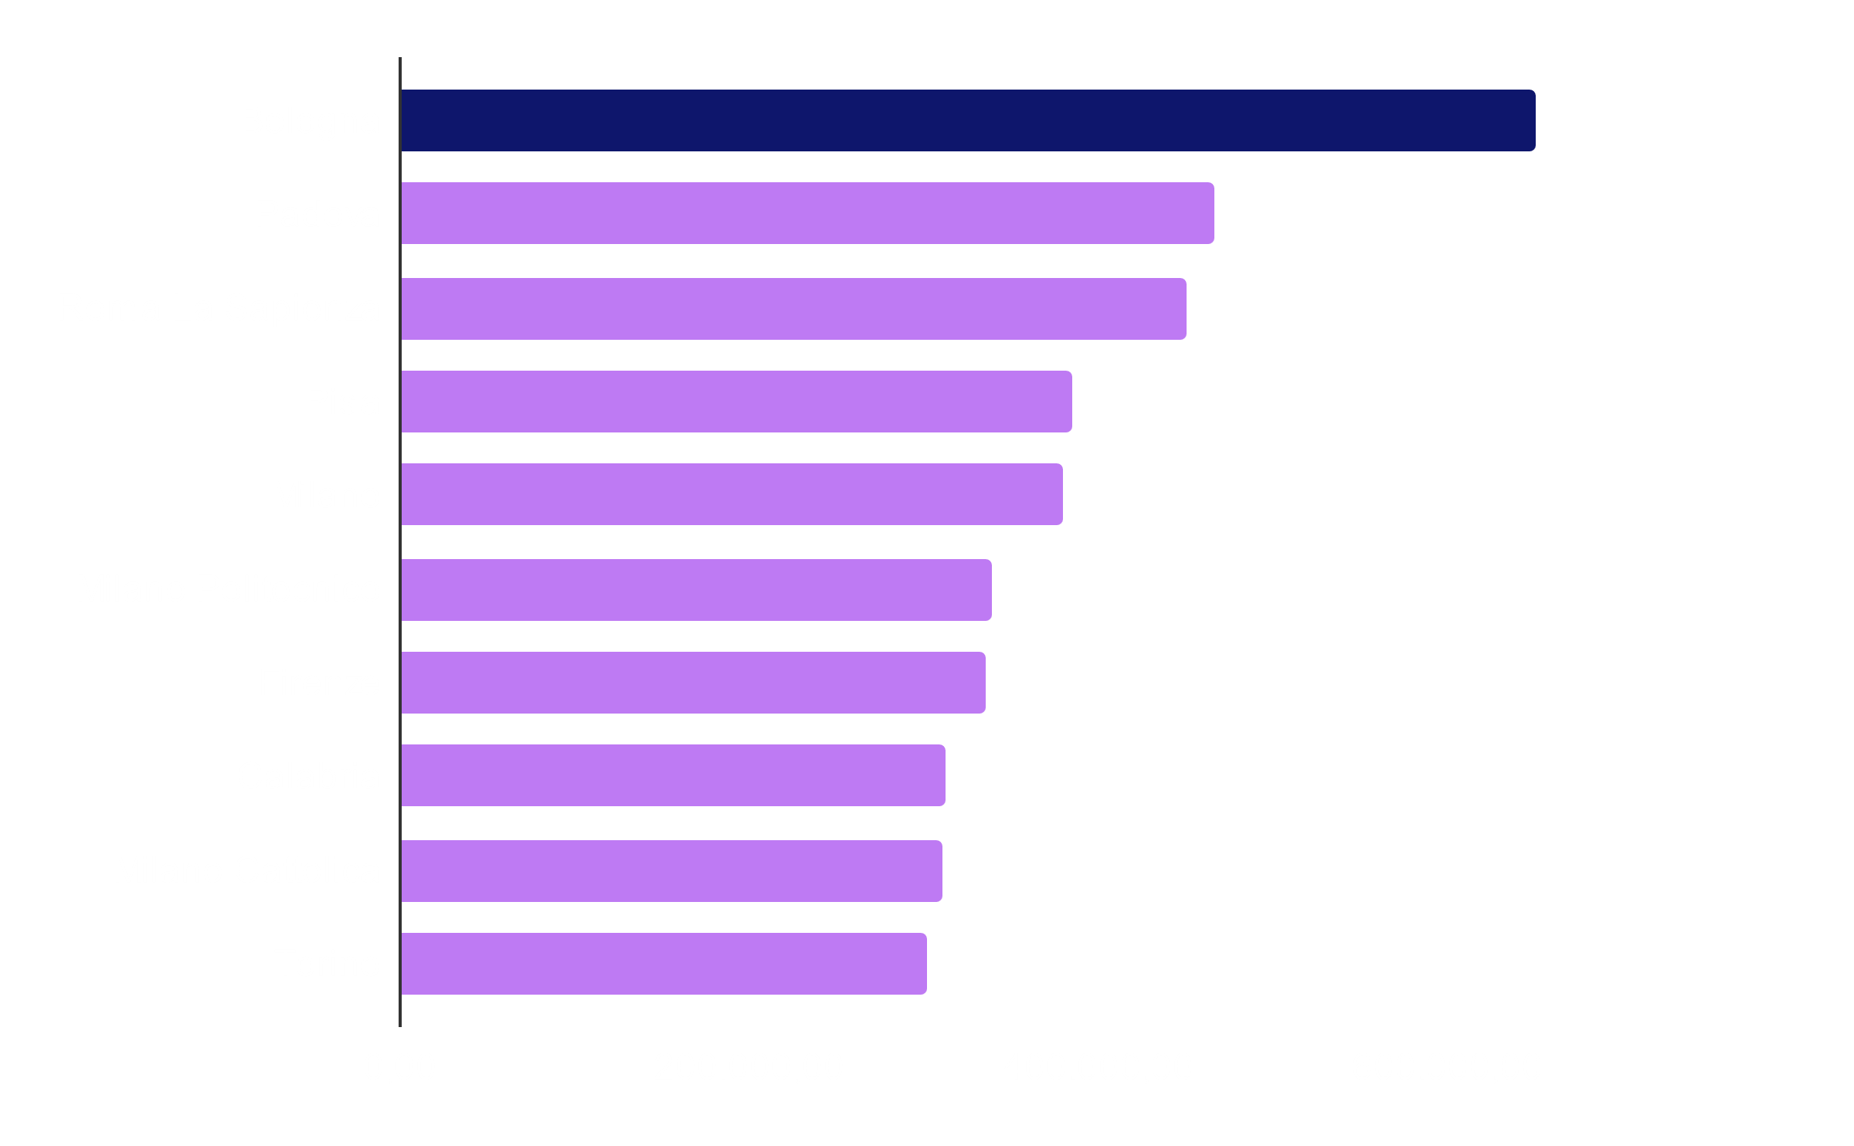
Out-of-town students
MENU
ANALYSIS
CONTACT
UNIVERSITY TRENDS
Out-of-town students choose more universities in high-scoring regions, and this is confirmed by the CENSIS ranking of the best Italian universities
Bologna (91.5)
Padova (88.5)
Firenze (86.2)
Source: ISTAT & CENSIS

Slide 38
predictive analysis
MENU
ANALYSIS
CONTACT
UNIVERSITY TRENDS

Slide 39

First year forecasting
MENU
ANALYSIS
CONTACT
UNIVERSITY TRENDS
Real value
linear prediction
Trend analysis
Despite the slight decrease in the first few years, the trend over the last five years shows rapid growth
Source: MIUR

Slide 40
Enrollment evolution
MENU
ANALYSIS
CONTACT
UNIVERSITY TRENDS
2003
2025
Best enrollment value, but start decrease
Growth may continue
1998
2014
Start increasing the enrollment
Worst enrollment value, but start new increasing

Slide 41
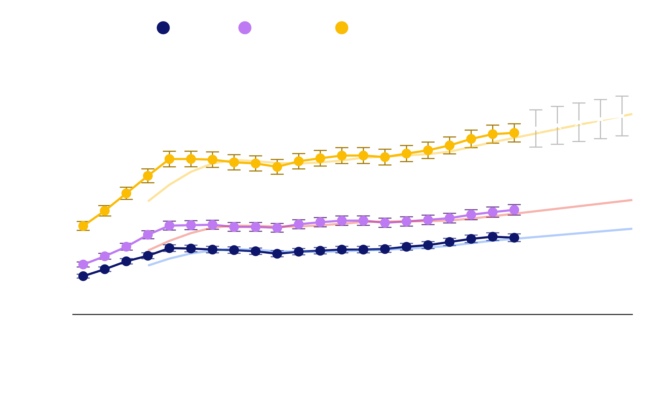
Graduates prediction
MENU
ANALYSIS
CONTACT
UNIVERSITY TRENDS
Forecast of graduates shows an upward trend until
2025
Source: MIUR

Slide 42
prescriptive analysis
MENU
ANALYSIS
CONTACT
UNIVERSITY TRENDS

Slide 43
—umberto eco
MENU
ANALYSIS
CONTACT
UNIVERSITY TRENDS
Di qualsiasi cosa i mass media si stanno occupando oggi, l’università se ne è occupata venti anni fa e quello di cui si occupa oggi l’università sarà riportato dai mass media tra vent’anni.
«
«

Slide 44
Students decisional params
MENU
ANALYSIS
CONTACT
UNIVERSITY TRENDS
3,05
3
3,75
3,35
2,05
1,95
University prestige
quality of services
educational offer
location proximity
experience
cost of choice
Source: ISTAT

Slide 45
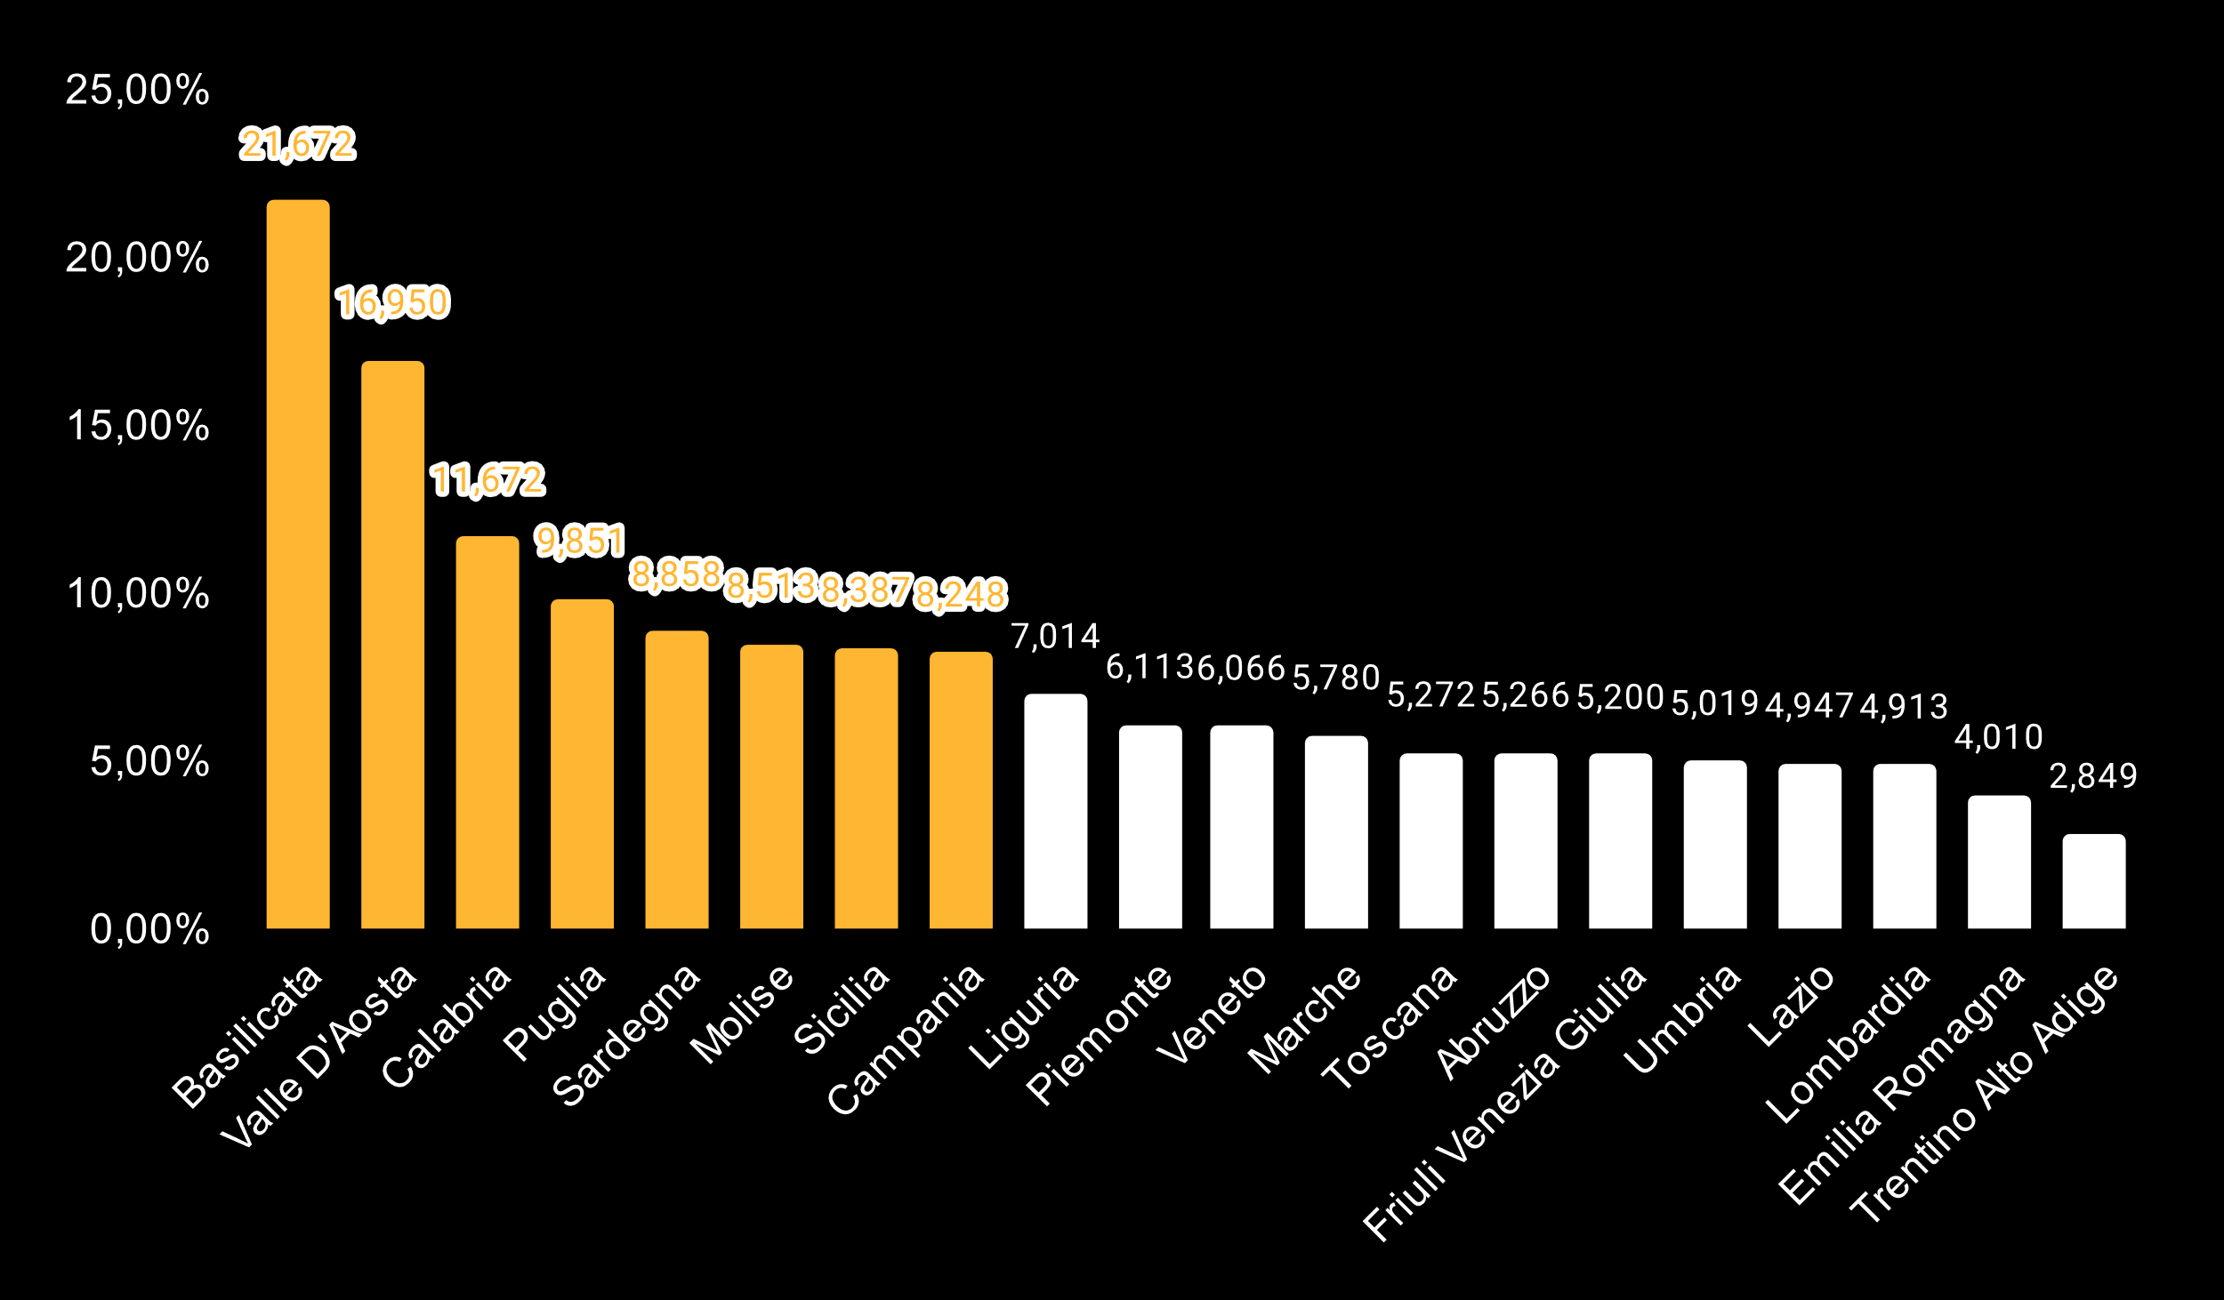
Why invest in the south?
MENU
ANALYSIS
CONTACT
UNIVERSITY TRENDS
The southern regions have the highest percentage in Italy of graduates out of the number of students enrolled in the last 10 years.
These regions churn out many students into the world of work and it is important not to waste any of them
Source: ISTAT

Slide 46

che tutto resti com’è bisogna che tutto cambi
MENU
ANALYSIS
CONTACT
UNIVERSITY TRENDS
Se vogliamo
Il Gattopardo

Slide 47
data visualization
MENU
ANALYSIS
CONTACT
UNIVERSITY TRENDS

Slide 48
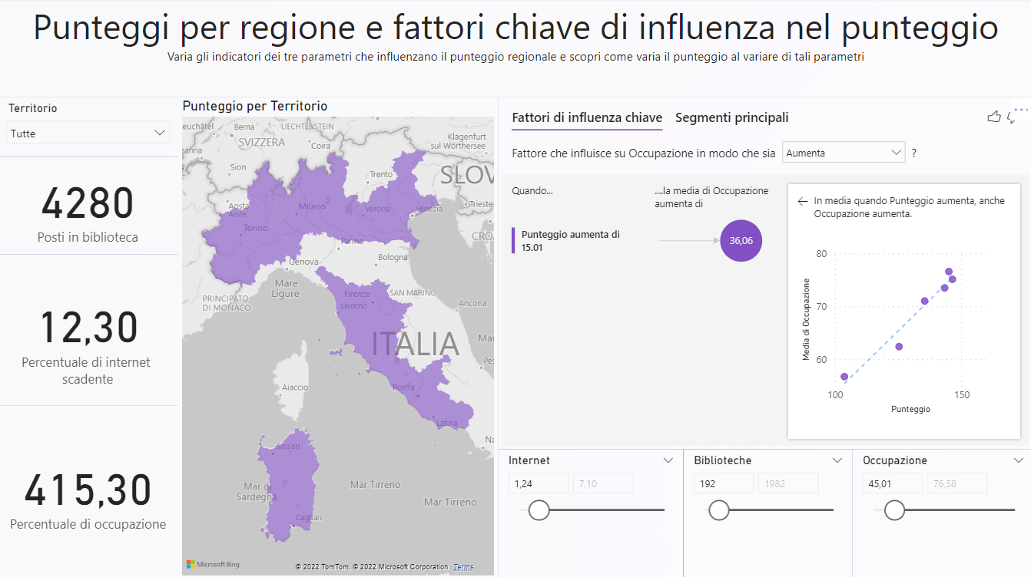
powerBI dashboard
MENU
ANALYSIS
CONTACT
UNIVERSITY TRENDS
In order to make the analysis more readable, it was decided to create dashboards using PowerBI

Slide 49
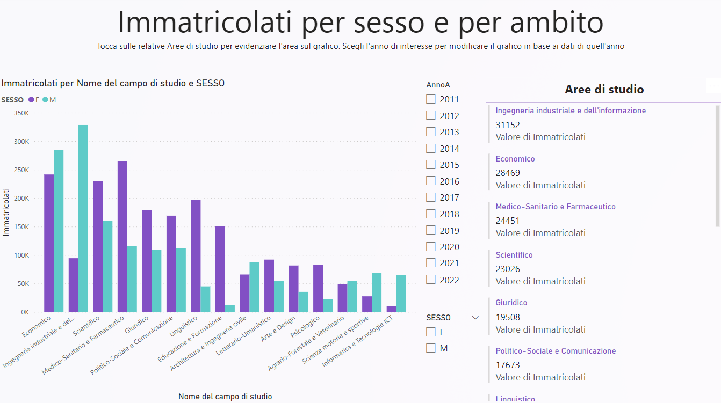
powerBI dashboard
MENU
ANALYSIS
CONTACT
UNIVERSITY TRENDS

Slide 50
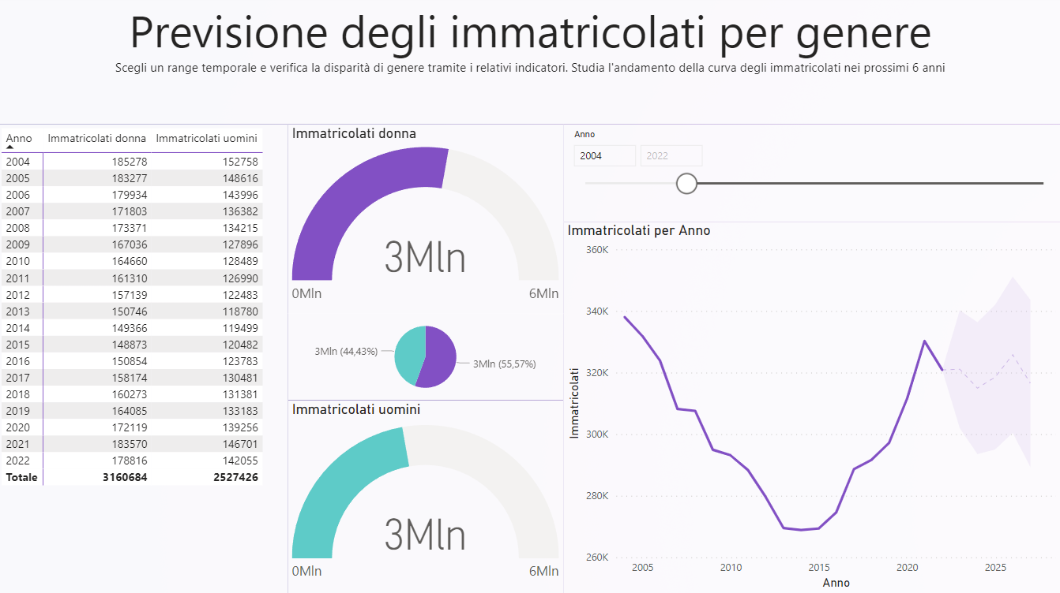
powerBI dashboard
MENU
ANALYSIS
CONTACT
UNIVERSITY TRENDS

Slide 51
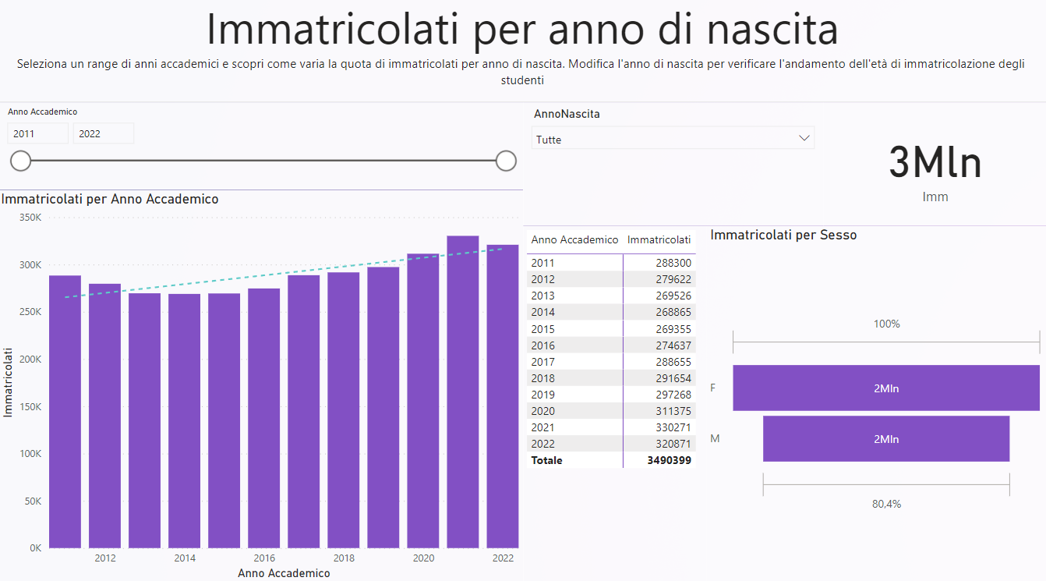
powerBI dashboard
MENU
ANALYSIS
CONTACT
UNIVERSITY TRENDS

Slide 52
CONTACT US!
linkedin
MENU
ANALYSIS
CONTACT
UNIVERSITY TRENDS
Domenico Benfenati
Carandente Vincenzo
instagram
@domenico.benfenati
@vincicar99
email
d.benfenati@studenti.unina.it
vince.carandente@studenti.unina.it

Slide 53
THANKS!
MENU
ANALYSIS
CONTACT
UNIVERSITY TRENDS
Do you have any questions?

